Slide 1

Causal Discovery for Effective Connectivity in Human Brains
October 2nd 2013
Ramon Janssen, Tom de Ruijter
Supervision by Max Hinne, Tom Claassen

Slide 2
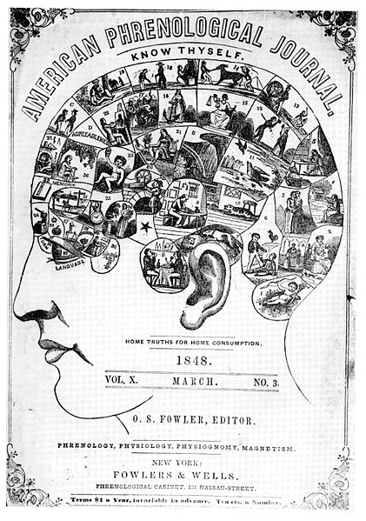
Phrenology
Finding cognitive ability and personality by measuring skull and brain
Still prominent in 1848

Slide 3
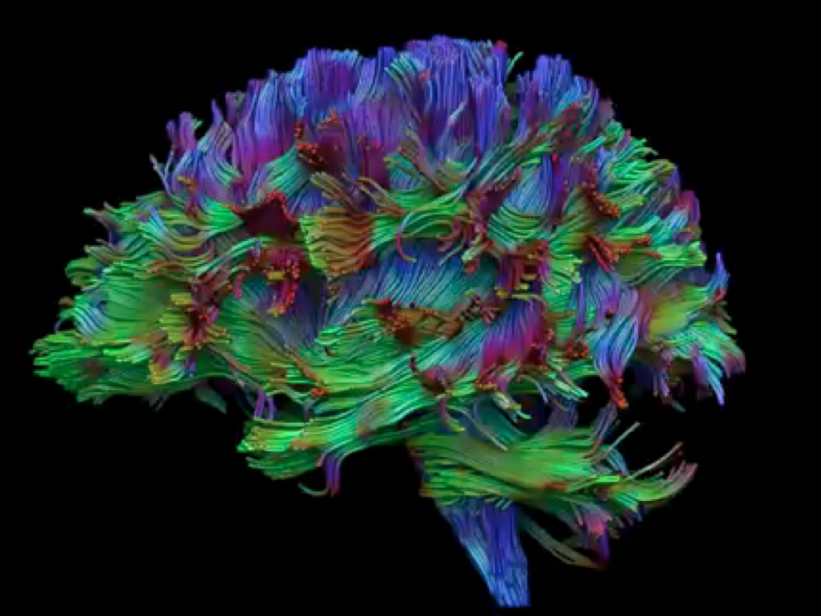
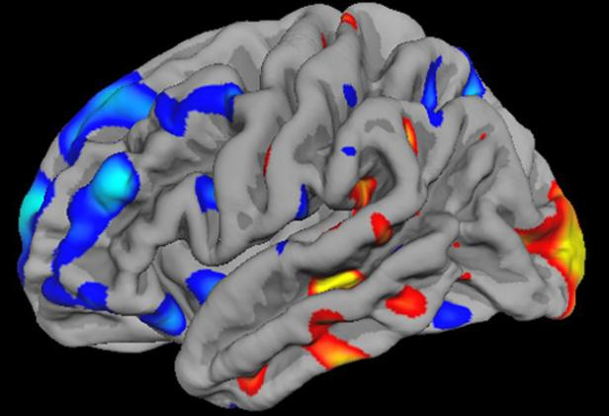
Modern brain science
Advanced imaging techniques
fMRI
DTI

Slide 4
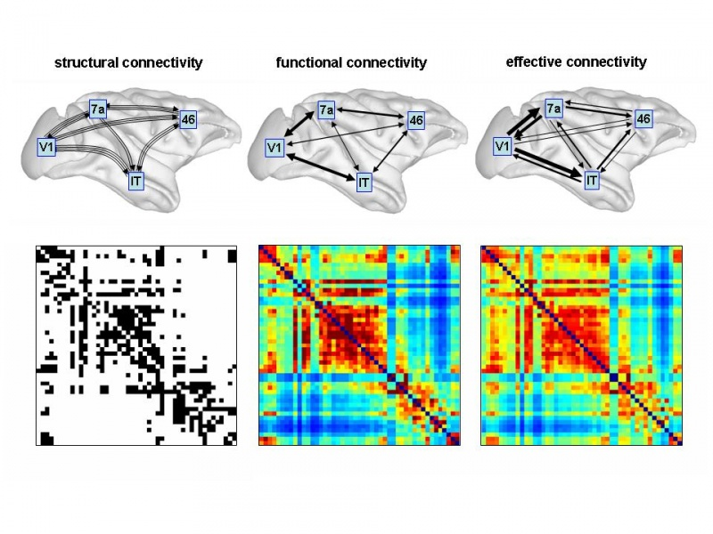
Brain Connectivity

Slide 5
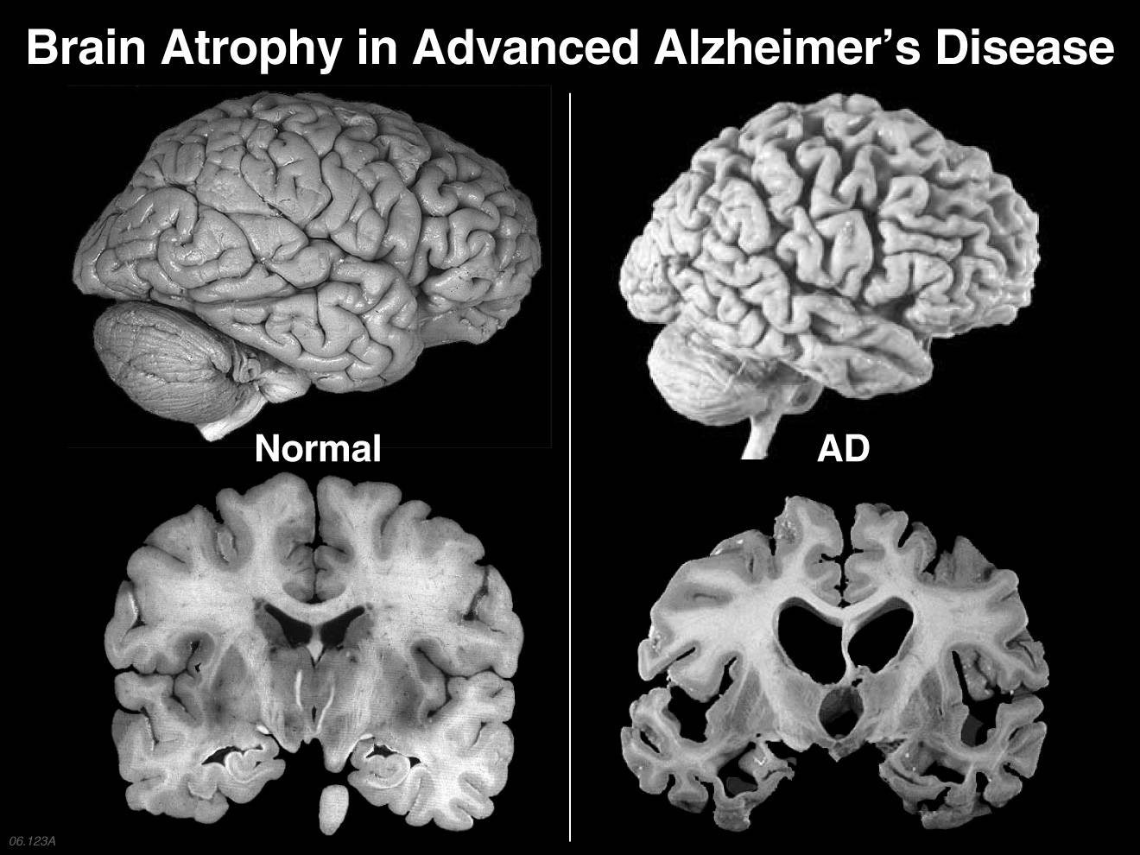
Neuro-degenerative diseases

Slide 6
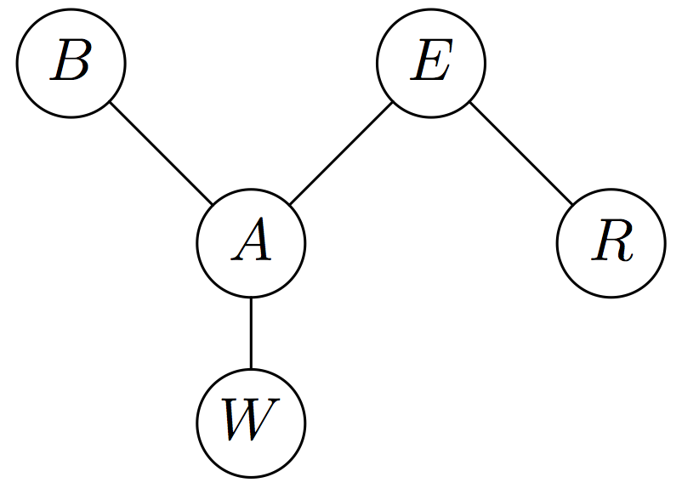
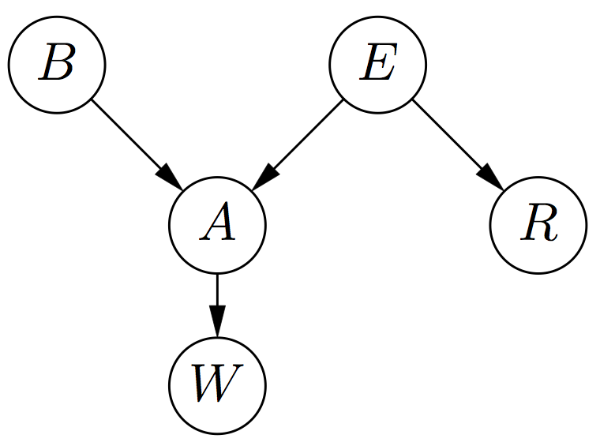
Causal discovery methods

Slide 7
Research problem
Can Causal Discovery help finding Effective Connectivity?

Slide 8
Problems with causal inference in fMRI
Scalability
Variance between subjects
Indirect measurement
Latent sources

Slide 9

Problems with causal inference in fMRI
Scalability
Variance between subjects
Indirect measurement
Latent sources
A
A
B
C
B
C

Slide 10
Data acquisition
6 subjects
fMRI and DTI data
Structural data and voxel time-series
Divided over 116 area’s / nodes
1029 timeseries measurements, each 2 seconds
Data is already available

Slide 11
Methods
PC (implement ourselves)
Widely used algorithm for causal inference
Can infer a network structure from functional connectivity.
Adds directions to arrows in this structure
Result is a partially directed graph
BCCD (implementation available)
Attempts to improve PC
Produces a distribution of directed graphs
Includes measure of uncertainty

Slide 12
Methods
Step one: inferring the structure
Can be skipped if a structure is already known
A
B
A
B
C
D
C
D
D
D
real network
inferred network

Slide 13
Methods
Step two: inferring the direction
A
B
A
B
C
D
C
D
D
D
real network
inferred network

Slide 14
Strategy & Timeline
Two tracks: with given structure and without
Week | 41 | 42 | 43 | 44 | 45 | 46 | 47 | 48 | 49 | 50
PC | Implementation |  |  | with structure
 |  |  |  | without structure
BCCD |  |  |  |  | Setup |  | with structure
 |  |  |  |  |  |  | without structure
Analysis |  |  |  | PC |  |  | BCCD
Writing |  |  |  | Write article

Slide 15

Thank you for your attention

